Slide 1
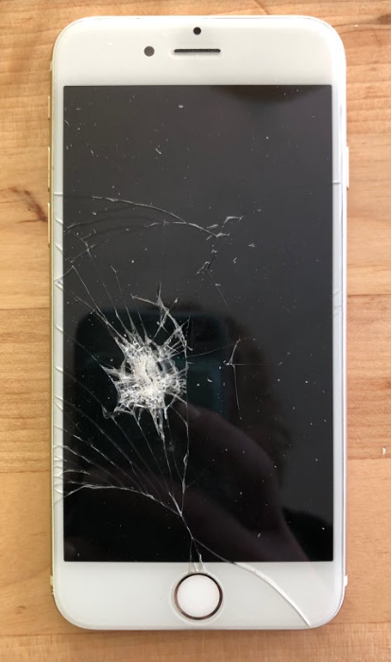
Slide A
Exploring a Phenomenon
Cell Phone Damage
Americans break 2 smartphone screens every second.
More than 50 million phone screens are cracked each year.
An estimated 95 million phones were damaged in the world by dropping them.
We spend $3.4 BILLION each year in replacing cracked screens--not counting the 38% of smartphone owners who don’t replace them at all.
27% of people said that their phone was in a case when they broke it.
Source- Miami Herald
Notes:
Introduce cell phone damage information. Display slide A. Say, I came across some interesting data about cell phone damages. Listen to the things I learned! Read each statistic aloud.
Americans break 2 smartphone screens every second.
More than 50 million phone screens are cracked each year.
An estimated 95 million phones were damaged in the world by dropping them.
We spend $3.4 BILLION each year in replacing cracked screens--not counting the 38% of smartphone owners who don’t replace them at all.
27% of people said that their phone was in a case when they broke it.
Say, This seems like a lot of cell phone damage happening in our world. That got me wondering how common this sort of phenomenon is in our classroom community. Have any of you ever experienced cell phone damage before?
Instruct students to raise their hands if they have experienced a situation where they have seen a phone get damaged.

Slide 2

Slide B
Breaking a Phone
Turn and Talk
Have you or someone you know ever broken a phone? What caused it to break? Describe your experience(s).
Be ready to share your experiences with the class!
Notes:
Elicit student experiences. Display slide B. Ask students to turn and talk with a partner about the slide question: “Have you or someone you know ever broken a phone? What caused it to break? Describe your experiences.”
Say, Wow, we seem to have a lot of experience with damaging cell phones! It sounds like some of you have been the ones to create the damage, and some of you have seen them damaged before.

Slide 3

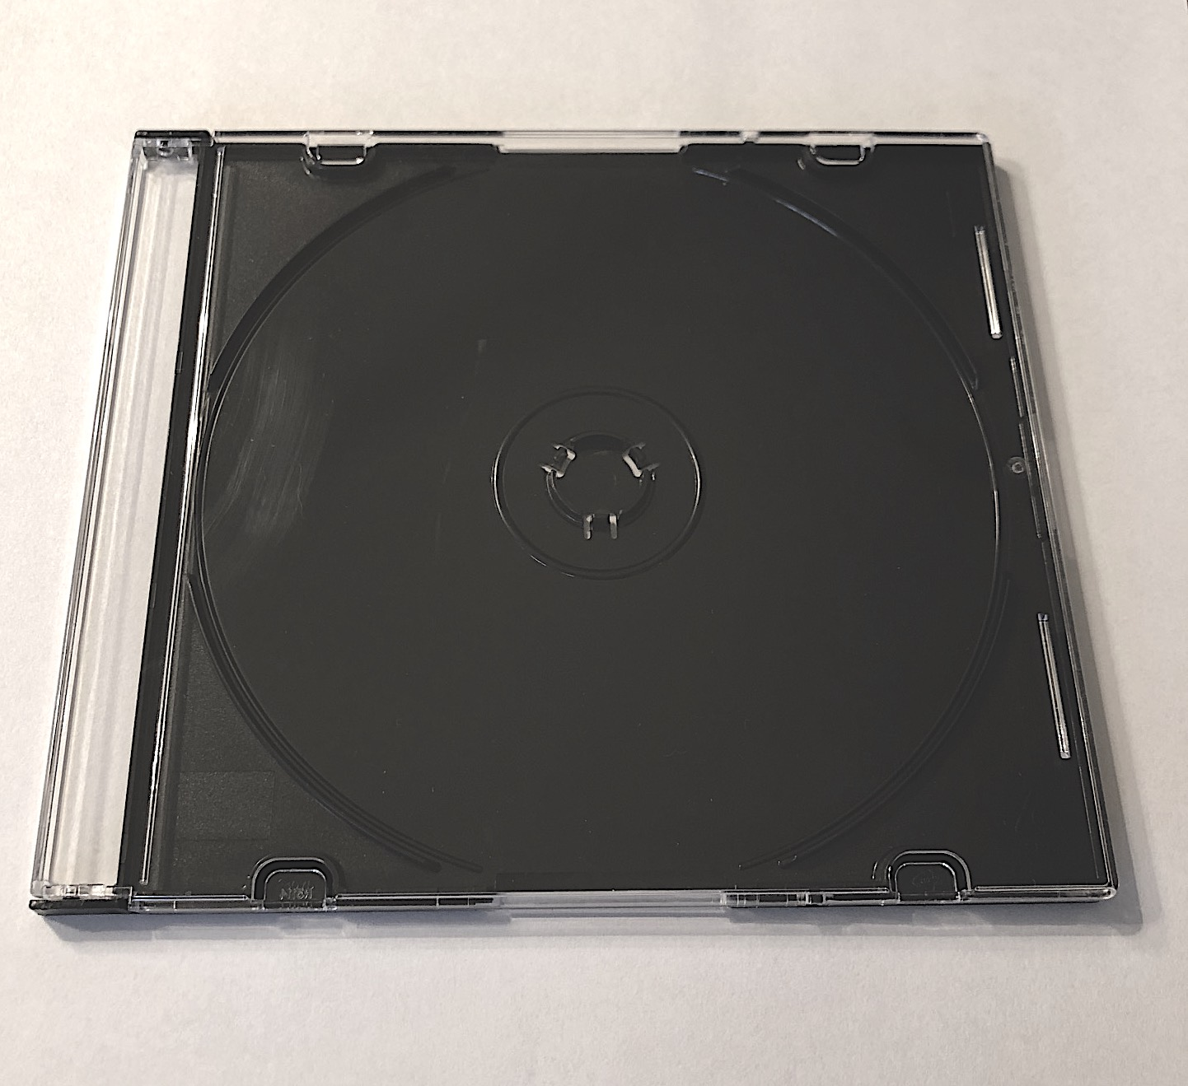
Using a CD Case to Model Phone Damage
Slide C
With Your Class
What damage to phones have you seen or experienced?
A few volunteers will use this CD case in place of a phone to show the class what happened to the phone.
Your teacher will draw a model to represent what happened as you share.
Notes:
Introduce a CD case to represent a phone in collisions. Display slide C. Say, I would love to hear about your experiences with phones breaking, but sometimes it's easier for us to understand a situation where something occurred when we can see a representation of how it happened rather than just hearing about it. Phones are expensive, so I have a CD case here that we are going to use as a substitute for a phone. I thought we could use this as a manipulative to represent what happened to the phone when it got damaged.
Demonstrate phone breaking experiences. Select one volunteer at a time to come up in front of the class and demonstrate what happened with the cell phone when it broke. Let students know it's OK if what they show us ends up causing the CD case to break too, as we want to try to understand the interactions that happened and the results as accurately as possible. Remind them to be responsible and avoid moving the CD case or any other object in a direction that might remotely come in contact with another living thing or fragile object.
Use the prompts from the teacher guide to elicit experiences from student volunteers so that you get at least one example that would represent each of the three collision types: A, B, and C.
As each student shares their experience, create a diagram on a blank piece of paper using squares to represent the two objects that collided. After creating each diagram, attach it on the Different Collisions poster. Draw large enough for students to see. The diagrams will become part of an anchor chart for students to refer to later. The three diagrams (A, B, C; that you will finish drawing in the subsequent conversation) should be similar to ones shown in the teacher guide. As you are drawing, remember to represent the phone as a white box and the other object as a shaded box instead of the actual objects being described by students. This will help students later to transfer and categorize the general diagrammatic representations into related phenomena experiences.
Discuss and alter frames of reference. Revisit the drawings and place the Different Collisions poster in a spot that is easily viewable for students, if not already in a prominent spot in the classroom. First, remove the piece of paper with collision type A that shows the diagram that has a moving, fragile object colliding with a motionless object (collisions type A). Use the prompts in the teacher guide to help students consider changes to the frame of reference.
Return collision type A back to the Different Collisions poster. If needed, remove the collision types B and C from the Different Collisions poster and repeat this line of questioning with collision types B and C.
Categorize remaining interactions. Ask students if they have any other stories that would be represented differently than our drawings. If a student says yes, have them demonstrate the interaction while you map it out on a blank piece of paper. Compare the interaction to the other collision types on the chart, turning it to see if the interaction matches any existing collision type scenarios. Help students draw the conclusion that the scenario is already on the collision types board by simply changing the frame of reference.
Introduce the word collision to students. Use the CD case, if necessary, to enact the moment when the “phone” touches another object for any of the three collision scenario types.
Say, There are a lot of words we can use to describe this phenomenon. When scientists describe this sort of phenomenon, where a moving object hits or runs into another object, they refer to it as a collision.
Display the poster that says “Different collisions”.
Motivate related phenomena. Say, These categories of collisions could be useful for thinking about other related phenomena where something other than a phone was involved in a collision. But not all collisions result in damage. Think of examples where something other than a phone was damaged in the collision. I also want you to think of examples where you were surprised that something other than a phone was not damaged in a collision.

Slide 4

Slide D
Related Phenomena - Other Collisions
Brainstorm
Other Collisions
Do the following on each index card:
Identify the objects that came into contact with each other during the collision.
Underline which object or objects were moving before the collision occurred.
List a collision where objects were damaged during the collision on a red index card.
List a collision where objects were surprisingly not damaged on a green index card.
Notes:
Document related phenomena on index cards. Project slide D. Read through the directions on the slide. Pass out 2-3 red and green index cards to each student. If red and green index cards are not being used, update slide D and slide E to reflect the colors of the index cards or sticky note being used.
Prompt students to record at least one collision where something has been damaged on red cards and at least one collision where something was surprisingly not damaged on green cards. For each thing listed, students should identify the objects that came into contact with each other during the collision and underline the object or objects that were moving before the collision occurred. Only one collision example should be written on each card.
Provide students approximately 5 minutes to generate and record their related phenomena cards. Encourage students to use as many cards as they need as they think of other examples.
Hang the Different Collisions poster to the left of the Related Phenomena poster. Then, circulate during the remaining time to help any student who may become stuck while trying to brainstorm examples.
With about a minute left, remind students to go back over their index cards and make sure that they have identified the objects that came into contact with each other during the collision and have underlined which objects were moving before the collision occurred.

Slide 5

Slide E
Related Phenomena - Other Collisions
The object that was damaged OR that you were surprised wasn’t damaged
Categorizing Examples
The other object
Are your collisions examples of scenario A, B, or C?
Label each of your red and green cards “A”, “B”, or “C”.
A
was moving at first
was motionless
at first
B
was motionless
at first
was moving at first
C
was moving at first
was moving at first
Notes:
Revisit the different collision types. Display slide E. Read through slide E and go over each type of collision, emphasizing what objects were moving or not moving before the collision. A quick reference list is below.
A- A moving object was damaged OR wasn’t damaged when it collided with a motionless object.
B- A motionless object was damaged OR wasn’t damaged when a moving object collided with it.
C- A moving object was damaged OR wasn’t damaged when it collided with another moving object.
Say, In class we have identified three different types of collisions. Let’s sort our related collisions into these categories and see if we notice any patterns or factors that may contribute to damage in the collisions. Look at your index cards and write the collision type at the top of each one--A. B. or C.
Have students ask an elbow partner to quickly check their collision types. If there is debate on the collision type, help students sort out the appropriate type individually.

Slide 6
Slide F
Related Phenomena - Other Collisions
Partner Share
The object that was damaged OR that you were surprised wasn’t damaged
The other object
In a moment, we will go to the areas of the room that go with our cards. First, we will do red cards (damage), then green cards (no damage).
While you are in your area, share your collision with a partner.
Look for any similarities and differences in how the collisions occurred.
How did damage (or no damage) occur?
A
was moving at first
was motionless
at first
B
was motionless
at first
was moving at first
C
was moving at first
was moving at first
Notes:
Share related phenomena. Display slide F. Students will organize themselves based upon related phenomena and share their phenomena with a partner. During this time students will be developing the idea of different factors or variables that impact damage.
Say, In a moment, you will get the chance to share your related phenomena with someone else. There are 3 sections of the room labeled A, B, and C. When I ask you to, you will look at the collision type on one of your cards and go to the area with that collision type. Once you are there, find someone and share your collision. As you share, be thinking about what is similar and different between the two collisions.
Ask students to look at one of their red, damage cards first. Direct them to move to the area of the room that matches their collision type. Give students 2 minutes to share and compare and contrast with their partners. After the two minutes are up, ask students to look at one of their green, no-damage cards. Direct students to move to the area that matches their green card collision type. Give students 2 minutes to share and compare and contrast with their partners.
Tell students to hand in all of their index cards and return to their seats.

Slide 7


Identifying Factors in a Collision
Slide G
Looking for Patterns and Variables
Create a T-chart in your notebook. Label one side “Patterns in collisions” and the other side “Factors and variables that might cause damage in a collision.”
Record any patterns you notice between collisions and collision types.
List any factors or variables that you think contributed to why some items got damaged and other items did not get damaged in a collision.
Factors and variables that might cause damage in a collision
Patterns in collisions
Notes:
Prepare science notebooks. Say, It seems like we were finding a lot of similarities, differences, and maybe even some important factors and variables across our collisions. Let’s make sure to record these ideas!
Identifying factors in a collision. Project slide G. Ask students to begin a new page in their science notebook to set up the related T-chart. Give students 4 minutes to record any patterns they saw in the collisions they discussed. Have students focus on looking for clues about possible factors or variables that would cause something to get damaged or not get damaged during a collision and record them on their charts. Some potential ideas for factors or variables include the following:
mass of the object
speed of the object
direction of the object
if the object was moving or not
angle at which the object was struck
material the object is made from
Organize related phenomena. While students complete their tables, use this independent writing time to tape the student-generated phenomena cards in the correct areas on the Related Phenomena poster. For larger classes, it is recommended to use 3 pieces of chart paper instead of 2 pieces to accommodate space for all index cards on the poster.

Slide 8

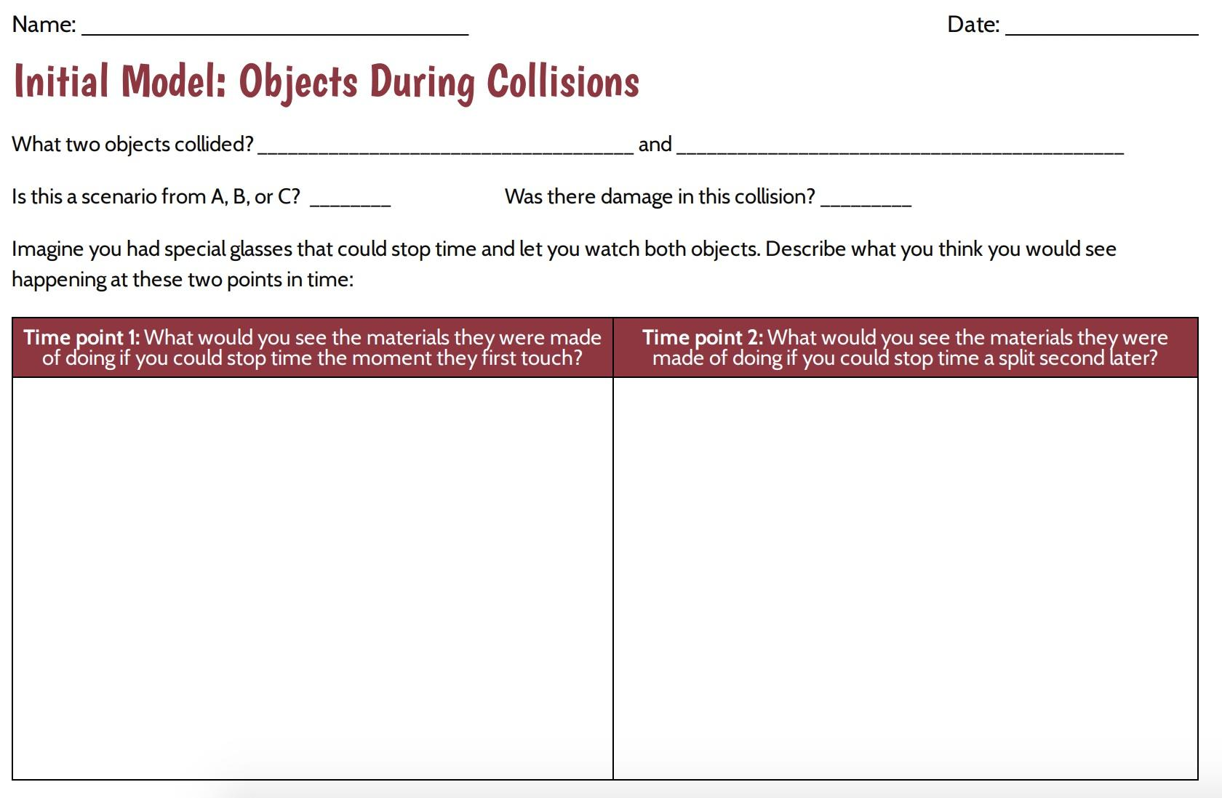
Slide H
Modeling Collisions
Notes:
Develop initial models of objects during a collision. Say, Let’s try to develop a model to explain what is happening when two things come into contact in a collision. Display slide H.
Distribute a copy of Initial Model: Objects During Collisions to each student. Tell students that they should put their name on their handout but don’t add it to their notebooks yet, as you want to collect it at the end of the period to get a sense of what they are thinking. Ask students to look at the Related Phenomena poster where they listed examples of things that have been damaged or surprisingly not been damaged in collisions. Ask students to pick one of these examples to explain on their handout.
Say, You are going to use this handout to develop a model to show what interactions are happening between the objects during a collision. On the first line, list the two objects that collided. Did you choose an example that matched collision type A, B, or C? List which scenario you chose. Look at the next question: Was there damage in this collision? Write “yes” if there was damage and “no” if there was not damage. Give students a minute to answer the first three questions on their handout before moving on to the boxes below.
Say, In the space below, imagine you could slow time down and could also freeze or pause the collision at different points in time. What do you think you would see happening to the materials right at the moment the objects first touched or made contact with each other in the collision? That’s this box on the left labeled “Time point 1”. How about a split second later? That’s the box on the right labeled “Time point 2”. Draw and label or describe in words what you think you would see happening for both objects at each time point.

Slide 9
Slide I
Modeling Collisions
Changes we could see: Now think about what you would see happening in between time point 1 and time point 2. Would you see any changes happening in each of the objects? How does that help explain why the object was damaged or not?
Interactions we cannot see: Now think about the interactions between time point 1 and time point 2 that you cannot see happening. What interactions would be happening? How does that help explain why the object was damaged or not?
If you picked a collision with no damage, then how would the interactions between the same objects have to change to cause damage in a collision?
If you picked a collision that caused damage, then how would the interactions between the same objects have to change to not cause damage in a collision?
Be ready to share your models with a partner.
Notes:
After 3-4 minutes, distribute Object Interactions During A Collision. Project slide I. Say, Look at the questions on this second handout and look at the model you just drew. The first question is asking you to think about what is happening with the objects between time point 1 and time point 2. What changes do you think you could see happening between those two points in time?
The second question asks you to think about the interactions that you cannot see happening with the objects in a collision. What interactions between those two points in time do you think you couldn’t see happening with those objects as they collided?
The third question wants you to think about what changes to these interactions might lead to more or less damage. When we are talking about their interactions, we are talking about the ways that they are acting on and affecting each other when they are touching. What changes to the way that they are acting on and affecting each other when they are touching would lead to more or less damage?
Give students the remaining time to consider the questions and respond. At the end of the class period, have students hand in Initial Model: Objects During Collisions and Object Interactions During A Collision for a formative assessment. If students have constructed the initial models in their notebooks, have students hand in their notebooks.

Slide 10
Sharing Initial Models
Slide J
Share Your Initial Model With a Partner
How did you represent things similarly or differently as they collided? Why did you represent them acting the way they do?
Compare the factors and variables that you each identified that may have contributed to the damage (or lack of damage).
Put a ✓ on your paper where you and your partner agree on ideas.
Put a ? next to areas where you disagree on ideas or have questions.
Notes:
Return materials to students. Return Initial Model: Objects During Collisions, Object Interactions During A Collision and science notebooks to students. If students used the loose handouts instead of recording in their science notebooks, give students time to attach the handouts to a notebook page using tape.
Form a Scientists Circle for the first time. Ask students to assemble their chairs in a circle and to bring their science notebooks and something to write with. Students will remain in the circle for all of class, though they will move among partner, small-group, and whole-class discussions. This will help minimize the movement of chairs throughout the class period. As students get more comfortable with the Scientists Circle, they can move between it and other activity structures more quickly. Ideally, they will need to be able to see the slides and have access to a whiteboard, but if that is not possible, use only the whiteboard (or chart paper), which is where the more critical sensemaking will occur for the rest of the class.
Share initial models with a partner. Display slide J. Ask students to keep track of similarities and differences between (1) what they think would happen at each point in time for each model and (2) the factors and variables that may have contributed to damage or no damage.

Slide 11
Classroom Norms
Slide K
Respectful Our classroom is a safe space to share. | We provide each other with support and encouragement. We share our time to talk. We do this by giving others time to think and share. We critique the ideas we are working with, but not the people we are working with.
Equitable Everyone’s participation and ideas are valuable. | We monitor our own time spent talking. We encourage others’ voices who we have not heard from yet. We recognize and value that people think, share, and represent their ideas in different ways.
Committed to our community We learn together. | We come prepared to work toward a common goal. We share our own thinking to help us all learn. We listen carefully and ask questions to help us understand everyone’s ideas. We speak clearly and loud enough so everyone can hear.
Moving our science thinking forward We work together to figure things out. | We use and build on others’ ideas. We use evidence to support our ideas, ask for evidence from others, and suggest ways to get additional evidence. We are open to changing our minds. We challenge ourselves to think in new ways.
Notes:
Introduce the idea of coming to consensus as a class. Tell students, Soon, we’ll try to come to agreement with all our diagrams. The purpose of introducing the consensus task before talking about classroom norms is to get students thinking about how difficult it will be to get all members of the learning community to agree and how we want to make sure everyone is included and all voices are heard.
Introduce science classroom norms. Tell students that before the class moves on with further investigations, it is time to set up some norms for how the class wants to work and learn together. You may want to reiterate productive behaviors you witnessed in the first day of Lesson 1 as a way of communicating to students that they were already operating using some positive norms, but they had not yet talked about them.
Display slide K and pass out the handout Science Classroom Norms. Note: Edit the handout and slide as desired for your classroom.
Remind students that in prior units we have used norms to help develop a productive and respectful learning environment. They are similar to rules but are intended to ensure that all students have a positive learning experience in science class.
The norms on the handout and the slide are a starting point for the class. It is important to talk through each one with students and ask them to provide an example or paraphrase the norm. The purpose of this is to develop a shared understanding of each norm. Also, provide opportunities for students to clarify a norm, ask for a modification, or develop a new norm. Allow students to write on their handouts if the class decides to change something. Norms are intended to be shared by the students and teacher, so even though a set has been provided, it is just a starting point.
Choose a norm to work on today. Ask students to read through the norms one more time, nominate one norm that may be particularly hard to follow, and suggest a strategy that could help everyone adhere to it. Then, before the students end their conversation, ask them to silently pick one norm from the sheet that they personally will work on today. Give them at least 30 seconds of quiet, individual think-time to make this decision.

Slide 12

Slide L
Initial Consensus Model Discussion
Develop a whole-group record of what we agree on and where we have competing ideas across the initial models.
As your classmates share their models, mark your model like this:
If something is similar, place a small check mark (✓) near what is similar on your own model.
If something is different, place a question mark (?) near what is different on your own model.
Notes:
Share initial models in the Scientists Circle. Display slide L. Arrange students around the Consensus Model for Collisions poster.
Say, Let’s start with a model of when the objects in the collision did have damage. Let’s have a couple of people share their ideas with the class.
Pick two students with different models from Initial Model: Objects During Collisions to come up and show their models to the class. Try to pick examples that look different than the others. Tell students that as their classmates share their models, they should place a small check mark (✓) near what is similar and a question mark (?) near what is different on their own model. Ask students to explain what they think is happening that we can and cannot see between the two objects.
Lead a Consensus Discussion to create an initial consensus model. Use the Consensus Model for Collisions poster to incorporate the areas on which we agree. Allow students to share their agreements and disagreements verbally as they naturally arise in the conversation. After you hear a few examples where there is both agreement and controversy, suggest that we should start recording some of these on our poster.
Say, This poster represents our whole-class thinking. We should feel free to say if it does not represent everyone’s thinking so we can figure out what we know and what we are less certain about. We will need to know if we have competing ideas in future lessons so we can figure out what we still need to investigate. Make sure to say something if this does not represent our whole-class thinking.
Shift to the column labeled ”Changes we can see” and ”Interactions we cannot see”. Start with the students’ responses for the changes we can see. Then move to the interactions we cannot see. Use two different colored markers to represent the two different categories of responses. Refer students to Object Interactions During A Collision for ideas on what we can all agree upon and areas of disagreement. Have students share out what changes we can see occurring between the two objects. Begin with the collision with the damage box and record student ideas. If students can agree across the class on a change we can see, put an exclamation point or other symbol to indicate that there is a whole-class agreement on this idea. If students do not agree on an idea or it does not represent every student’s thinking, add a question mark beside the idea. If students have an idea as something that can be seen as well as cannot be seen, star the idea with the marker use to represent the other category (can be seen vs. cannot be seen) to represent that this idea falls into the two different categories (visible and nonvisible) and will be revisited in later lessons. An example of this can be seen in the chart below. On the example chart in the teacher guide, fracturing was listed first as an interaction we cannot see AND a change that we can see. A pink star was added next to it to indicate that it falls into both categories.
After potential agreements and disagreements have been identified and recorded, move to the remaining empty box that represents a collision without damage.

Slide 13
Developing Questions
Slide M
On Your Own
Label a new page “Initial Collision Questions.”
Look at the Consensus Model for Collisions poster.
What new questions do you have about the objects in a collision and the changes that might happen during a collision?
Write the question(s) in your notebook.
Notes:
Reflect and record questions. Project slide M. Take a moment to reflect on this Consensus Model for Collisions poster as a class. Ask students to title a new page in their notebooks “Initial Collision Questions” and record on that page any new questions they have regarding the initial consensus model. We want to make sure to capture these wonderings we have about what is happening during the collision while we still have them fresh in our minds. These questions will be revisited while creating stickies to add to the Driving Question Board on day 3.
Say, Wow, we’ve captured a lot of questions. All of these appear to be related to the ideas we were discussing about what was occurring during the collision. Let’s take a different perspective now and think about what other variables and factors in the system might influence whether a collision would result in damage or no visible damage from before the objects were even touching.

Slide 14
Slide N
Going Public with Factors and Variables
With Your Class
Patterns in collisions
Factors or variables that might cause damage in a collision
Look back at your Patterns in collisions chart.
Share any factors or variables that might affect the amount of damage in a collision.
Notes:
Show slide N. Have students look back at the Patterns in collisions T-chart in their notebooks.
Create a public record of students’ ideas. Display the Factors and Variables poster.
Say, This will be a record of our initial ideas, and even though we might all agree on some of these being important variables, we don’t yet know how important each one is or which variables or factors make the biggest difference, so I want to put a question mark next to each to indicate that as we quickly record a running list of different possibilities you share.
If students become stuck on wanting to not add a question mark to a particular idea that is shared (e.g., we are all certain that mass is an important factor), ask questions such as these:
Is X factor or variable more influential in a collision than Y factor or variable?
So is this factor or variable more important than another factor or variable in a collision?
Would this factor or variable still have as much of an impact on the outcome as this other factor or variable. What if we changed only this one variable instead of the other or vice versa?
Record student ideas. Students might suggest these ideas:
speed of the moving object(s)
size, weight, or mass of the moving object(s)
shape of the objects
material those objects are made of
how hard or soft those objects are
the angle they hit each other from
any padding or protective material around either object
At the end of the period, ask students to think more about what factors and variables that are not on our chart might have an affect on the outcome of a collision. Students can ask family, friends, or community about what they think affects damage in a collision if they need more ideas.
It is OK if you do not complete this chart during this class period. It will be revisited at the beginning of day 3.

Slide 15
Classroom Norms
Slide O
Respectful Our classroom is a safe space to share. | We provide each other with support and encouragement. We share our time to talk. We do this by giving others time to think and share. We critique the ideas we are working with, but not the people we are working with.
Equitable Everyone’s participation and ideas are valuable. | We monitor our own time spent talking. We encourage others’ voices who we have not heard from yet. We recognize and value that people think, share, and represent their ideas in different ways.
Committed to our community We learn together. | We come prepared to work toward a common goal. We share our own thinking to help us all learn. We listen carefully and ask questions to help us understand everyone’s ideas. We speak clearly and loud enough so everyone can hear.
Moving our science thinking forward We work together to figure things out. | We use and build on other’s ideas. We use evidence to support our ideas, ask for evidence from others, and suggest ways to get additional evidence. We are open to changing our minds. We challenge ourselves to think in new ways.
Notes:
Choose a norm to work on today. Display slide O. Tell students, We will spend all day in our Scientists Circle again, working on turning our ideas into questions that we can investigate. Direct them to look over the Classroom Norms chart again. Ask students to nominate a norm that the class should work on as a group. Take a vote and choose a norm to focus on together today.
Say, What strategies can we use to stick to this norm together? Solicit 2-3 student ideas before revising the Factors and Variables poster.

Slide 16
Slide P
Revisit Factors and Variables
With Your Class
Patterns in collisions
Factors or variables that might cause damage in a collision
Look back at your Patterns in collisions chart.
Did anyone come up with any new factors or variables that we should add to our class chart?
Notes:
Project slide P. Revisit the Factors and Variables poster with students. Ask if they have identified any other factors that may affect damage in a collision. Record student ideas on the poster.

Slide 17
Developing Additional Questions
Slide Q
On Your Own
Look at your notebook and the Patterns in collisions chart.
What new questions do you have about the changes that might happen during a collision and what affects the outcome?
Write the question(s) down on your index card or sticky note.
Write one question per sticky note or index card.
Write in marker--big and bold.
Put your initials on the back of each note in pencil.
Notes:
Write additional questions individually. Project slide Q. Pass out 1-2 index cards or sticky notes to each student. Remind them that though we generated questions last time based on what was happening during the collision, they may have new questions about some of these variables and factors from today. Direct students to look back at their Initial Collision Questions notebook page and the Factors and Variables poster. Ask students to use a marker to write on the sticky notes or index cards one or two questions they have developed, one question per card. They should write their questions so they are big and bold. We want to be able to see the questions clearly. Remind students that it will be part of our mission over the next few weeks to try to answer these questions as well as the ones they wrote last time.

Slide 18

Slide R
Driving Question Board (DQB)
Take out your sticky notes with questions. Bring those with you to our Scientists Circle along with your science notebook.
The first student reads a question aloud to the class, then posts it on the DQB.
Students who are listening should raise their hands if they have a question that relates to the question that was just read aloud.
The first student selects the next student whose hand is raised.
The second student reads a question, says why or how it relates, and posts it near the question it most relates to on the DQB.
That student selects the next student.
If another student has shared the same question that you have, try to share a different question that has not been shared.
We will continue until everyone has at least one question on the DQB.
Notes:
Start our Driving Question Board (DQB). Before class begins, be sure to have the DQB set up in the room. Place the Consensus Model for Collisions poster near the DQB. Say, We have been analyzing different types of collisions and the results of those collisions. We have identified possible variables and factors that contribute to damage or no damage, and we want to find out exactly how those collisions cause damage.
Write the unit question at the top of the DQB: “Why do things sometimes get damaged when they hit each other?” Give students a moment to gather their index cards from the last activity and record any new questions on new index cards they may have related to collisions.
Gather in a Scientists Circle around the DQB. Display slide R. Instruct students that when they have their questions ready, they need to bring them and chairs to meet in a Scientists Circle around the DQB. Explain to students how you will create the DQB (also shown on slide R):
The first student reads a question aloud to the class, then posts it on the DQB.
Students who are listening should raise their hands if they have a question that relates to the question that was just read aloud.
The first student selects the next student whose hand is raised.
The second student reads a question, says why or how it relates, and posts it near the question it most relates to on the DQB.
That student selects the next student.
If another student has shared the same question that you have, try to share a different question that has not been shared.
We will continue until everyone has at least one question on the DQB.
Organize questions into categories. As students share, questions will naturally start clustering into similar parts of the model or similar questions. Once students have finished their sharing, ask them to identify the categories of questions and write these category names near each cluster of questions. To stay on track, save at least 8 minutes of class time for students to think about investigations. See the image in the step above for an example of student questions divided into potential categories. If you are short on time, create candidate categories yourself after this lesson, post them, and then share these with students at the start of the next class, asking them to make any suggested modifications to these if they think they don’t quite capture the themes that emerged on the board.
An example of a Driving Question Board created using student questions from a pilot classroom can be found in the teacher guide

Slide 19
Slide S
Ideas for Investigations
What kinds of investigations could we do and/or what additional sources of data might we need to figure out the answers to our questions?
Add your ideas to a new notebook page titled “Ideas for future investigations and data we need.”
Ideas for future investigations and data we need
Be prepared to share these with the whole class.
Notes:
Stay in a Scientists Circle to brainstorm investigations. Show slide S. Read the slide. Give students about five minutes to individually record in their notebooks some ideas for future investigations. As students are doing this, create a new poster titled “Ideas for Investigations and Data We Need.” Put this right next to the DQB.
Tell students that you are going to record their ideas and that you want everyone’s idea to be represented. As students are sharing their ideas, underline repeated statements to keep track of common ideas among students. Emphasize that the list is what we want to do that we think might help us answer our questions and that we may need to add to this list and update our DQB throughout the unit as we go.

Slide 20
Slide T
Looking Forward
We have a mission to accomplish as a class!
Our questions represent what it is we hope to be able to figure out.
Our ideas for investigations and sources of data will help us try to figure this all out.
Let’s get started exploring in our next class!
Notes:
Forecast that we will investigate our questions. Display slide T. Say, Wow. We have accomplished so much. We now have a broad mission to accomplish as a class. That is thanks to all the questions you shared and how you connected them together. These questions really represent what it is we hope to be able to figure out. And we have a lot of ideas for investigations we could do to try to figure this all out. I am very excited for us to be able to get started on investigating all of this. Let’s plan to start exploring some of those questions and ideas in our next lesson.

Slide 21
Classroom Norms
Slide U
Respectful Our classroom is a safe space to share. | We provide each other with support and encouragement. We share our time to talk. We do this by giving others time to think and share. We critique the ideas we are working with, but not the people we are working with.
Equitable Everyone’s participation and ideas are valuable. | We monitor our own time spent talking. We encourage others’ voices who we have not heard from yet. We recognize and value that people think, share, and represent their ideas in different ways.
Committed to our community We learn together. | We come prepared to work toward a common goal. We share our own thinking to help us all learn. We listen carefully and ask questions to help us understand everyone’s ideas. We speak clearly and loud enough so everyone can hear.
Moving our science thinking forward We work together to figure things out. | We use and build on other’s ideas. We use evidence to support our ideas, ask for evidence from others, and suggest ways to get additional evidence. We are open to changing our minds. We challenge ourselves to think in new ways.
Notes:
Debrief how we did with our focal norm. Display slide U. Have students turn and talk and share how they did with the norm they selected. Ask students, How did the norms help us talk together and come up with some ideas of what we think is happening? Allow a few students to share and tell students they will continue to work on the norms.
Update the table of contents with students. Say, But before we start on one of our investigation ideas, let’s organize the work we have done so far. Take any remaining time to have students update their table of contents and page numbering to include references to all the work they have done so far. Develop a sample table of contents with students on chart paper to show one way to name the work they have in their notebooks and reference the related pages it is on. If you run out of time for this today, make sure to do this before the start of the next lesson the next time you meet.

